Slide 1
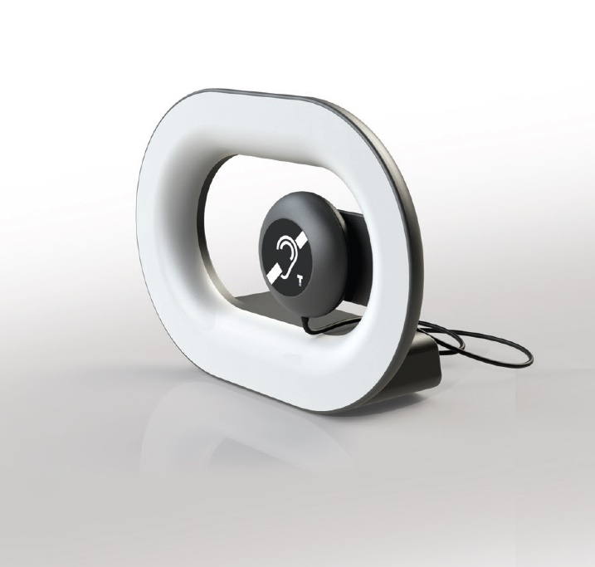
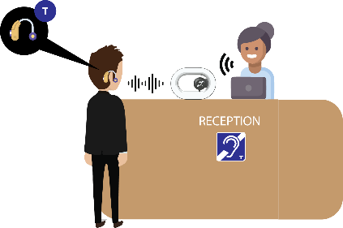
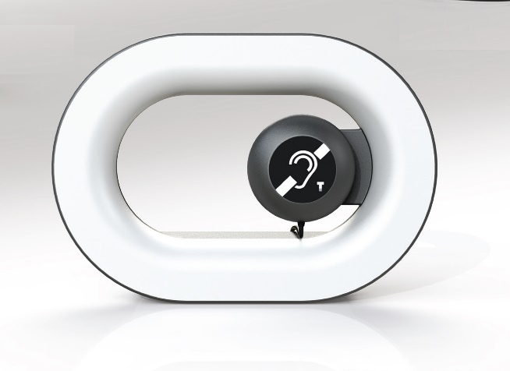
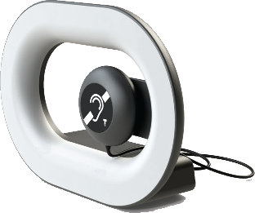
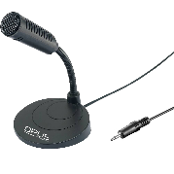
eLoop
Portable loop amplifier
When hearing accessibility becomes design...
The eLoop is the latest generation of counter loop amplifier from Opus Technologies. Thanks to its compact conception and its power, eLoop is perfectly suitable for being integrated into a variety of environments such as receptions, banks, post offices, information centers, airports...
This system guarantees a clear communication for hearing people equipped with hearing aids. e-Loop features a microphone capsule at its back, an amplifier, a loop and a rechargeable ion lithium battery 18650 of 3.7V.
The eLoop+ kit is a complete installation composed of the eLoop unit, a handset and a gooseneck microphone OP-M80 ensures a better signal source and supplies accessibility solutions to people non-equipped with hearing aids.
The 2 potentiometers at the back of the unit allows to adjust the emission level of the magnetic field and the handset sound level.
Power up and current level LEDs are visible at the front and the back of the unit. It allows to inform the public that the devise is in function and that they can switch their devices into T-coil.
eLoop is delivered with a fixation support which allows to create a fixed base to the product. However it is possible to pull out the unit of this support to move easily the devise to another workspace.
eLoop has been developed with strict and rigorous specifications that meet the IEC 60118-4 norm
Class D : High efficency and low battery consumption
Elegant design
Plug and Play
Conform with the IEC-60118-4 standard
Conform : CE, ROHS
Made in France
Application :
Office
Reception
Airport
Information center
Post office
Etc
eLoop+
eLoop | eLoop unit with fastening support and signage stickers
eLoop+ | eLoop unit, handset, external microphone OP-M80 with a fastening support and signage stickers
9 chemin de la vieille ferme
33650 MARTILLAC
France
contact@opus-technologies.fr
www.opus-technologies.fr
Phone: (+33)9.81.24.00.06

Slide 2
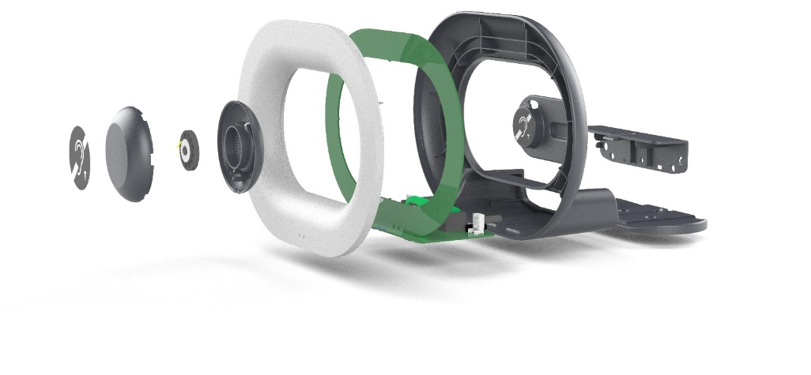
eLoop
Portable loop amplifier
When hearing accessibility becomes design...
AUDIO INPUT
Integrated microphone | Capsule microphone
Microphone plug | 1x 3.5mm Micro Jack
Phantom power supply | 5V, 1mA (external micro option)
AUDIO OUTPUT
Headphone plug | 1x 3,5mm Micro Jack
BATTERY POWER SUPPLY
Voltage / Current charger | 5 Vdc / 1,5A
Connector charger | Micro USB
Type | Li-Ion 3,7V 4000mAh
Autonomy | 10 hours
Charge time | 4 hours
PRODUCT SPECIFICATIONS
Dimensions | 250x185x80mm
Net weight | 366g
Packaging | Cardboard
Shipment dimensions | 400x250x100
Shipment weight | 1Kg
LEDS DISPLAY
Information | Charging battery (1) Low battery (2) Output current (3) Power supply (4)
(1)
(2)
(4)
(3)
4 allée Pierre Gilles de Genes
33650 MARTILLAC
France
contact@opus-technologies.fr
www.opus-technologies.fr
Phone: (+33)9.81.24.00.06

