Slide 1
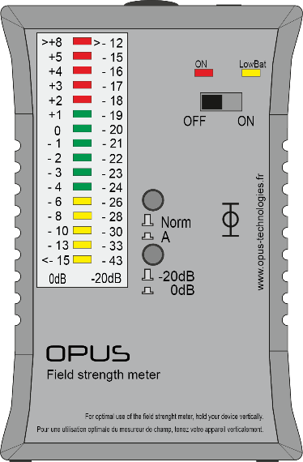
OP-FSM
Tester and magnetic field meter
The OP-FSM is an ideal solution for measuring, adjusting and commissioning a magnetic induction loop system in accordance with the IEC 60118-4 specification.
It allows precise measurement of the field strength in an area covered by a magnetic induction loop.
The LOW adjustment range is designed to measure crosstalk between loop systems and interference from network equipment such as lights, dimmers, or hardware.
It is equipped with a filter to measure the audio signal of the loop that the human ear hears and also broadcasts the test signals.
All measurements are taken at 0dB defined as 100mAM-1 RMS using a next-line PPM response rectifier.
Specifications
Scale calibration
Operating mode-20dB | -20dB = 0,043A/m
Operating mode 0dB | 0dB= 0,4A/m
Type of measurement | True RMS 125ms
Frequency response
Filter | A/Flat
30Hz...500Hz | -3dB...-4dB
500Hz...2500Hz | +/- 0,25dB
2500Hz...10KHz | +/-3dB
Outputs
Display | Color-coded LED dot display
Headphones | 3,5mm cinch
Power supply
Batteries | 2xAA
Incator lights | LED
Service life | 100h
Dimensions
Dimensions (L x H x P) | 83 x 126 x 35 mm
Weight | Approx. 300g
contact@opus-technologies.fr
www.opus-technologies.fr
Phone: (+33) 09.81.24.00.06

