Slide 1
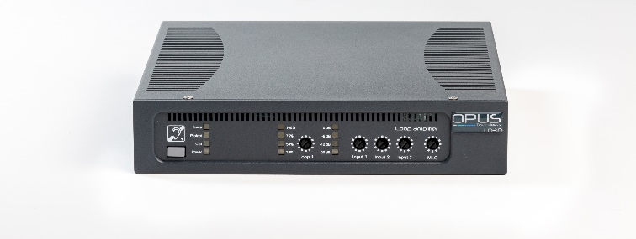
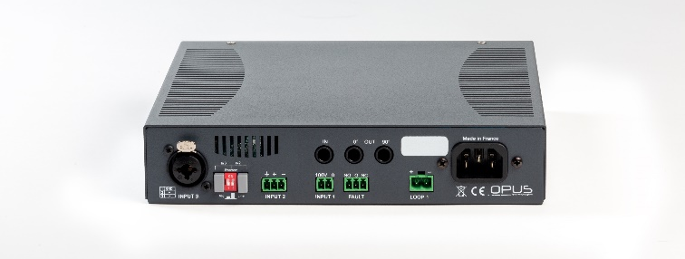
LD SERIES
LD1.0/2.0/3.0
Simple loop driver
Class D Amplifier
LDx.0 amplifiers from Opus Technologies are next generation induction loop Class-D amplifiers. The one channel amplifiers offer all the functionalities (AGC, MLC, compressor, etc) to ensure room installations up to 250m² (LD1.0), 450m² (LD2.0) or 1000m² (LD3.0).
Thanks to high frequency switching mode proprietary solutions, the amplifiers are one of the most compact on the market and do not need any active cooling. They include a LEDs indicator fault synthesis on the driver’s front panel to control the integrity of both loop and amplifier. Informations can be deported thanks to a dry contact relay.
The high-grade power supply and output voltage capability (48Vpk) ensure outstanding sound quality with high dynamic and extremely low distorsion.
The amplifiers can also be used in a low diaphonic phased loop system or an ultra high coverage system with a built-in 90 ° or 0 ° phase shift module (2 amplifiers).
Amplifiers have been developed with strict and rigorous specifications that allow us to offer a 5 year warranty and meet the IEC 60118-4. LD1.0, LD2.0,LD3.0 amplifiers follow strict specifications required for UL compliance.
One channel amplifier
High frequency switching mode
Efficiency up to 92%
Natural cooling
AGC: Automatic Gain Control optimized for speech
3 inputs wirh selectable gain
70/100V priority alarm input
Phantom supply for microphone
Slave amplifier input, output and 90% dephased output
Adjustable metal losses correction
1U wall mounting available
Compact and light
5-Year warranty
LEDs indicator
Relay fault systhesis
IEC 62368/UL compliant
Over current, over temperature and short circuit protections
Coverage
Cover meets the IEC 60118-4 standard
Loop | No metal loss |  |  | Moderate metal loss |  |  | High metal loss
 | Perimeter loop | Single array in 8 | Low overspill* | Perimeter loop | Single array in 8 | Low overspill* | Perimeter loop | Single array | Low overspill*
LD1.0 | 250m² (10x25m) | 450m² (15x30m) | 450m² (15x30m) | 130m² (10x13m) | 180m² (10x18m) | 450m² (15x30m) | Use Multi Loop Systems LDx.2 and/or Contact us
LD2.0 | 450m² (15x30m) | 650m² (20x32,5m) | 650m² (20x32,5m) | 160m² (10x16m) | 280m² (8x35m) | 650m² (20x32,5m)
LD3.0 | 1 000m² (16x62m) | 1 400m² (35x40m) | 1 400m² (35x40m) | 250m² (10x25m) | 360m² (10x36m) | 1 400m² (35x40m)
*with 2 amplifiers
contact@opus-technologies.fr
www.opus-technologies.fr
Phone: (+33)9.81.24.00.06

Slide 2
LD SERIES
LD1.0/2.0/3.0
Simple loop driver
Class D Amplifier
 | LD1.0 | LD2.0 | LD3.0
Coverage surface | 250 m² (10*25 m²) | 450 m² (15*30 m²) | 1000 m² (20*45 m²)
Power input
Voltage | 100-240Vac, 50-60Hz | 100-240Vac, 50-60Hz | 100-240Vac, 50-60Hz
Consumption at idle with 1Ω loop connected | 9W at 230Vac and 25°C ambient temperature | 9W at 230Vac and 25°C ambient temperature | 9W at 230Vac and 25°C ambient temperature
Nominal power consum 25W 50W 90W Ption at 1Ω
Maximum power consumption | <250 VA | <300 VA | <350 VA
Connector | IEC C13 | IEC C13 | IEC C13
Audio input
Input channels with separated adjustable gain | Input 1: 70/100V signal (priority dignal) Input 2: Microphone or line Input 3: Microphone or line | Input 1: 70/100V signal (priority dignal) Input 2: Microphone or line Input 3: Microphone or line | Input 1: 70/100V signal (priority dignal) Input 2: Microphone or line Input 3: Microphone or line
Phantom supply | Available on microphone inputs: 12V | Avaiblable on microphone inputs: 12V | Available on microphone inputs: 12V
Sensitivity | Microphone: -50 dB Line: -10 dB 100V: +40 dB | Microphone: -50 dB Line: -10 dB 100V: +40 dB | Microphone: -50 dB Line: -10 dB 100V: +40 dB
Connector | MTSB terminal block and/or Combo Neutrik for input 3 | MTSB terminal block and/or Combo Neutrik for input 3 | MTSB terminal block and/or Combo Neutrik for input 3
Audio ouput
Loop impedance | 0.5 Ω to 3 Ω | 0.5 Ω to 3 Ω | 0.5 Ω to 3 Ω
Max ouput current | 5 Arms, 7 Apeak 7.5 Arms, 10Apeak 10 Arms, 14Apeak
Max output voltage | 34 Vrms, 48 Vpeak | 34 Vrms, 48 Vpeak | 34 Vrms, 48 Vpeak
THD | <O.5% at nominal ouput current, 1Ω loop, -3 dB | <O.5% at nominal ouput current, 1Ω loop, -3 dB | <O.5% at nominal ouput current, 1Ω loop, -3 dB
Bandwidth | 80 Hz to 9.5 kHz, -3 dB | 80 Hz to 9.5 kHz, -3 dB | 80 Hz to 9.5 kHz, -3 dB
contact@opus-technologies.fr
www.opus-technologies.fr
Phone: (+33)9.81.24.00.06

Slide 3
 | LD1.0 | LD2.0 | LD3.0
Audio output
Dynamic | >36 dB | >36 dB | >36 dB
Metal loss correction | 0 to 3dB per octave filter | 0 to 3dB per octave filter | 0 to 3dB per octave filter
Connector | MTSBA terminal block | MTSBA terminal block | MTSBA terminal block
Slave Amplifier
Input / outputs | One input, one direct output and one 90° dephased output | One input, one direct output and one 90° dephased output | One input, one direct output and one 90° dephased output
Connectors | Jack 6.35 mm | Jack 6.35 mm | Jack 6.35 mm
LEDs indicator
« Power » | Switched on when module powered | Switched on when module powered | Switched on when module powered
« Protect » Switched on when signal clipping, too high temperature reached or in case of loop failure
« Loop » | Switched on when the loop is in working conditions | Switched on when the loop is in working conditions | Switched on when theloop is in working conditions
« Clip » | Switched on when slave input level is too high or slave amplifier is faulty | Switched on when slave input level is too high or slave amplifier is faulty | Switched on when slave input level is too high or slave amplifier is faulty
Vu meters « Input » | Input signal level after adjustement | Input signal level after adjustement | Input signal level after adjustement
Vu-meters « output » | Percentage of maximum current drawn | Percentage of maximum current drawn | Percentage of maximum current drawn
NO/NC fault relay synthesis (contact closed once one fault is detected)
Detected faults | Too high temperature raised and loop failure | Too high temperature raised and loop failure | Too high temperature raised and loop failure
Maximum electrical rating | 0.5A/125Vac or 1A/24Vdc | 0.5A/125Vac or 1A/24Vdc | 0.5A/125Vac or 1A/24Vdc
Connector | MTSB terminal block | MTSB terminal block | MTSB terminal block
General
Protections | Over current, over temperature, short circuit | Over current, over temperature, short circuit | Over current, over temperature, short circuit
Operating temperatur | 0 to + 45°C | 0 to + 45°C | 0 to + 45°C
Storage temperature | -30 to +70°C | -30 to +70°C | -30 to +70°C
Size | 42x200x215 mm / 1.6x7.9x8.5 inch | 42x200x215 mm / 1.6x7.9x8.5 inch | 42x200x215 mm / 1.6x7.9x8.5 inch
Weight | 1,56kg / 3,43Ibs | 1,56kg / 3,43Ibs | 1,56kg / 3,43Ibs
contact@opus-technologies.fr
www.opus-technologies.fr
Phone: (+33)9.81.24.00.06

