Slide 1
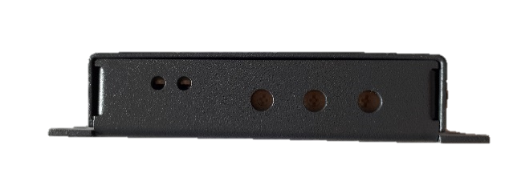
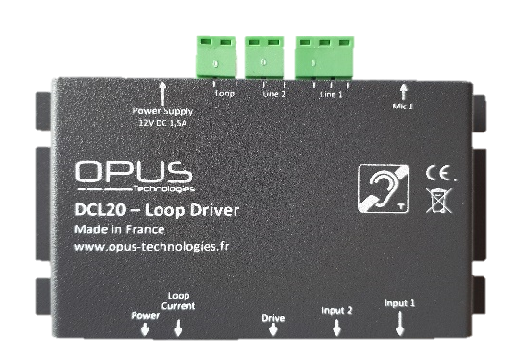
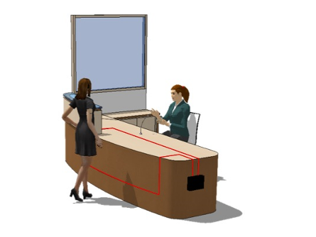
DCL20
Proximity/local loop amplifier
DCL20 is an induction loop kit which enables to equip reception desks or counter. This system enables to meet equal opportunity standards and to respect IEC-60118-4 standard requirements. The amplifier is designed to be discreetly fixed under a desk or a counter. It includes two inputs, settings and LED which shows the existence of the power block and the loop power.
The provided kit includes the induction loop amplifier, a microphone, a loop, a power block and 3 « adapted for hearing-impaired area » stickers. The device includes an audio processing which enables to have an automatic sound recording level enslavement avoiding loud and sudden noises.
Supplied with complete kit
2 inputs : 1 micro/line and 1 line
Phantom power
Functionning indicator
Output proctection
Small size (92x52x18mm)
> 2A peak current capacity
Compressor and noise blanker
Output power mode
Warranty : 5 years
Input
Audio input | 2 (1 micro or line input and 1 line input)
Type | Micro jack 3,5, terminal block
Phantom | 4,5V 1mA
Power
Caractéristics | 12V DC 1,5A
Type | Separated power block
Voltage | 230V 50/60 Hz
Power | 20W max
Fuse | Thermal
Audio processor
Compressor | Variable 1 : 1 to 20 : 1
Automatic gain control | AGC optimized for speech dynamic > 36dB
THD | < O,5% @1ohm / 1KHz / nominal current
Bandwith | 100Hz -> 8,5KHz
Dynamic | > 60dB
Output
Type | Current
Loop impedance | 0,1 Ohm to 1 Ohm
Peak current | 3,5A
RMS Power | 2A to 1 KHz
Protection | Thermal, short-circuit
Size and weight ( mm)
DCL20 | 92 x 52 x 18 (L x H x P)
Packaging | 190 x 190 x 50
Weight | 0,850 kg
contact@opus-technologies.fr
www.opus-technologies.fr
Phone: (+33)9.81.24.00.06

Slide 2
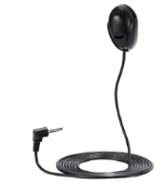
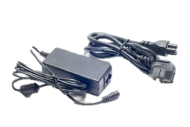
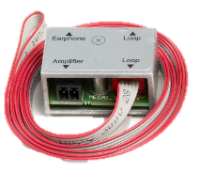
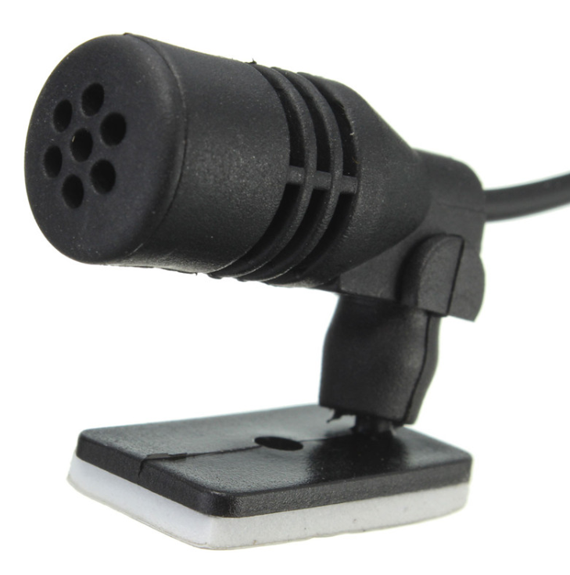
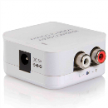
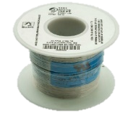
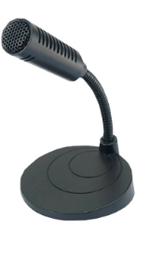
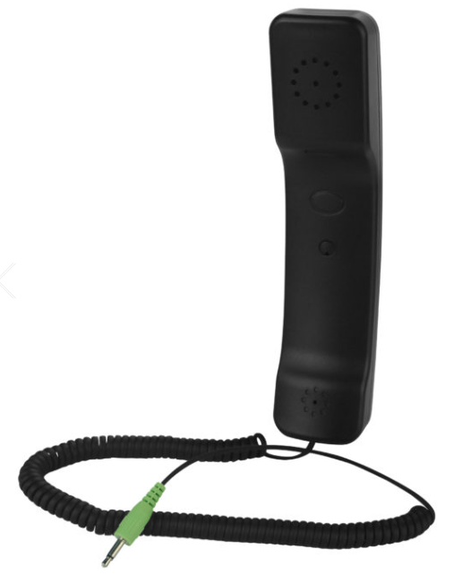
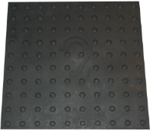
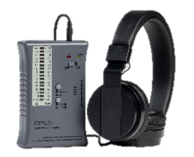
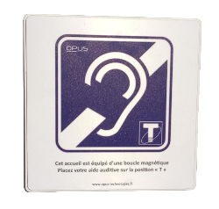
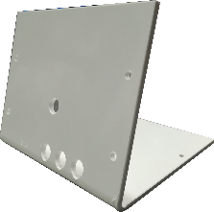
DCL20
Proximity/local loop amplifier
KIT
ACCESSORIES INCLUDED IN THE KIT | DCL20-SK Kit for counters | DCL20-E2 Kit for counter with headphones | DCL20-K1 Kit for counters with gooseneck micro | DCL20-K2 Kit for counters with handset | DCL20-TV Kit for TV rooms | DCL20-SA Kit for 50m² rooms
 | DCL20 amplifier Power block Surface micro Loop with RJ11 connections RJ11 adapter -> Phoenix terminal block Fixing sticker clip for loop 2 « adapted for hearing-impaired area » stickers | DCL20 amplifier Power block Surface microphone Headhone OP-E2 Loop with RJ11 connections RJ11 adapter -> Phoenix terminal block Fixing sticker clip for loop 2 « adapted for hearing-impaired area » stickers | DCL20 amplifier Power block Gooseneck microphone Loop with RJ11 connections RJ11 adapter -> Phoenix terminal block Fixing sticker clip for loop 2 « adapted for hearing-impaired area » stickers | DCL20 amplifier Power block Gooseneck microphone Handset Loop with RJ11 connections RJ11 adapter -> Phoenix terminal block Fixing sticker clip for loop 2 « adapted for hearing-impaired area » stickers | DCL20 amplifier Power block Surface microphone Coil 35 m Loop with RJ11 connections RJ11 adapter -> Phoenix terminal block 2 « adapted for hearing-impaired area » stickers | DCL20 amplifier Power block Surface microphone Digital signal adapter RJ11 adapter -> Phoenix terminal block 2 « adapted for hearing-impaired area » stickers
ACCESSORIES
OP-M
PS-20
OP-IL
Miniature surface microphone for DCL20 with jack 3,5.
12V 1 5A power block for DCL20.
Replacement loop for reception desk
OP-M02
OP-Toslink
OP-IL50
Miniature surface microphone for DCL20 with jack 3,5.
Coaxial Analog Optical Digital Audio Signal Adapter 5v
Coil of 50m of cable 1x0.52mm²
OP-M80
OP-E2
MATLOOP
OP-M80 is an optionnal microphone for proximity amplifier such as DCL20-K. It enables to provide a clear and audible sound in all situations to people with hearing-aid.
Headset in handset form for DCL20
MatLoop is a 600 x 600 mm mat including a magnetic loop for hearing-impaired pople who own hearing-aid with T position reception.
OP-FSM-02
OP-WALL2
OP-CW2
Field Strength Meter in accordance. Provided with the OP-778 headphones
The OP-WALL2 is a rigid PVC board connected to the induction loop of your reception.
Dimensions : 170x170x12mm
Easel for OP-WALL2 and DCL20
contact@opus-technologies.fr
www.opus-technologies.fr
Phone: (+33)9.81.24.00.06

